Slide 1
ARTIFICIAL INTELLIGENCE & MACHINE LEARNING
SQuAD CONNECT – 03/28/18

Slide 2
ETP – A definition of ML
“A computer program is said to learn from experience E with respect to some task T and some performance measure P, if its performance on T, as measured by P, improves with experience E.” –
- Tom Mitchell, Carnegie Mellon University

Slide 3
Types of Learning
Supervised machine learning: The program is “trained” on a pre-defined set of “training examples”, which then facilitate its ability to reach an accurate conclusion when given new data.
Unsupervised machine learning: The program is given a bunch of data and must find patterns and relationships therein.

Slide 4
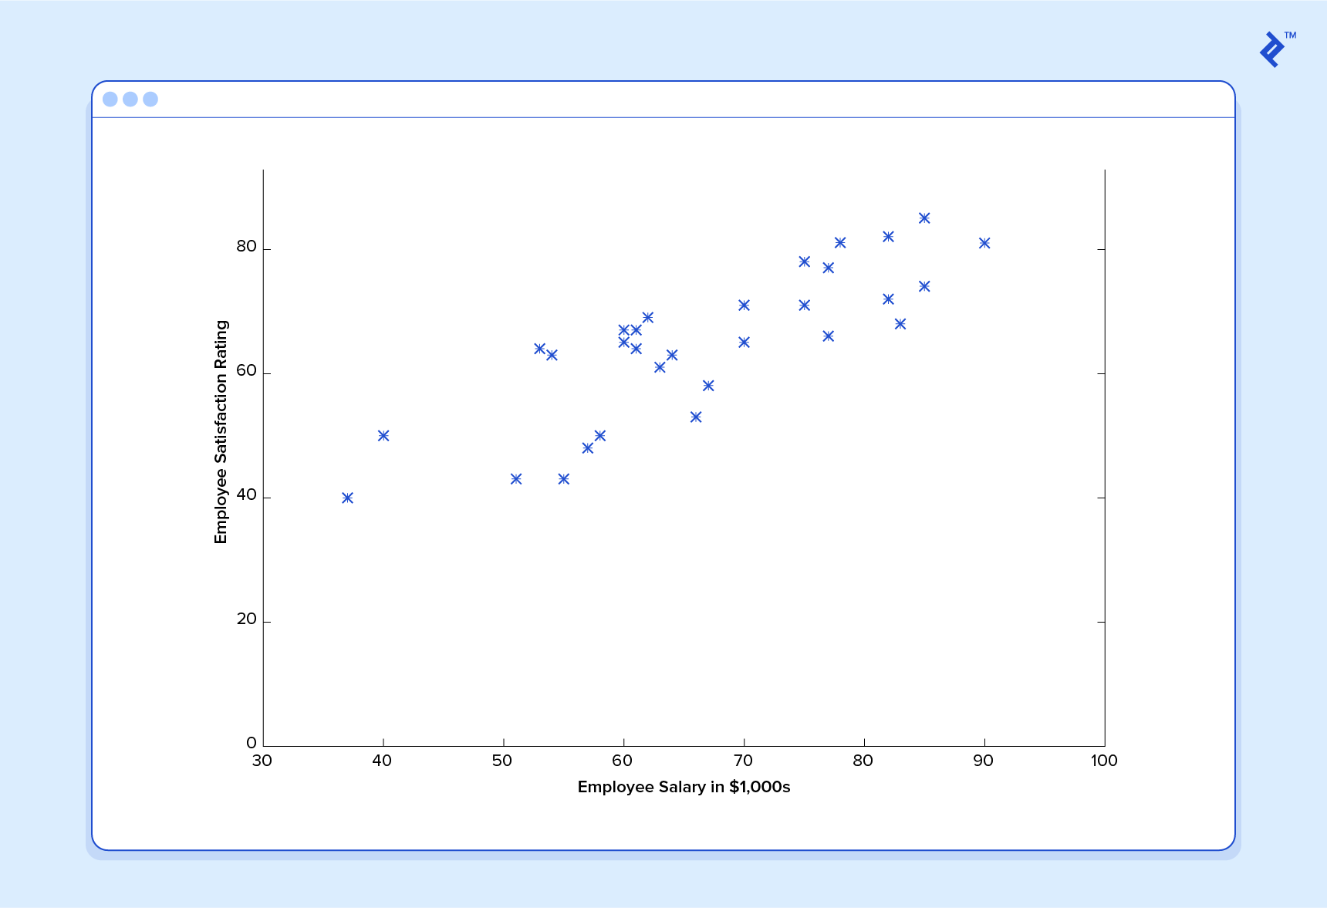
We have the following training data, wherein company employees have rated their satisfaction on a scale of 1 to 100:

Slide 5
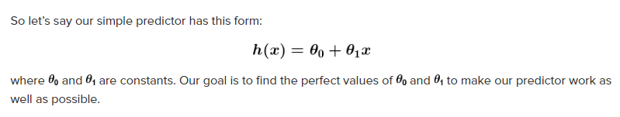
Goal of ML
The goal of ML is never to make “perfect” guesses, because ML deals in domains where there is no such thing. The goal is to make guesses that are good enough to be useful.

Slide 6
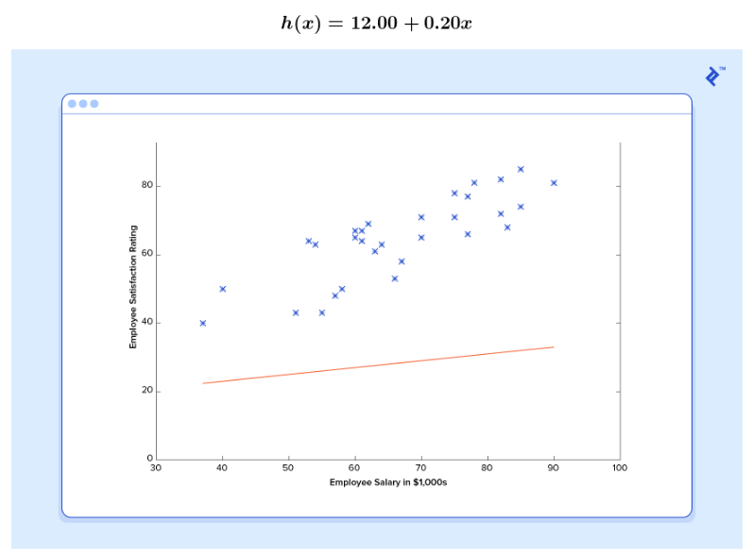

Slide 7
Learning
Give this predictor all the salaries from our training set
Take the differences between the resulting predicted satisfaction ratings and the actual satisfaction ratings of the corresponding employees

Slide 8
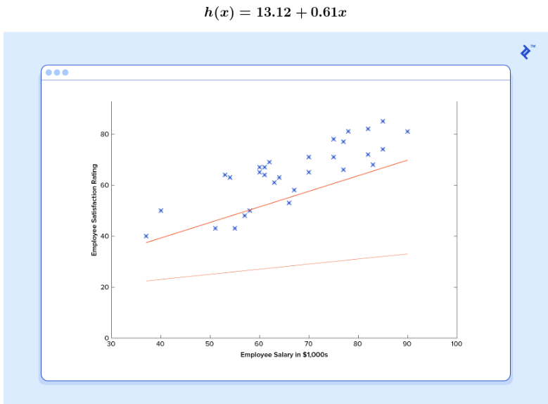

Slide 9
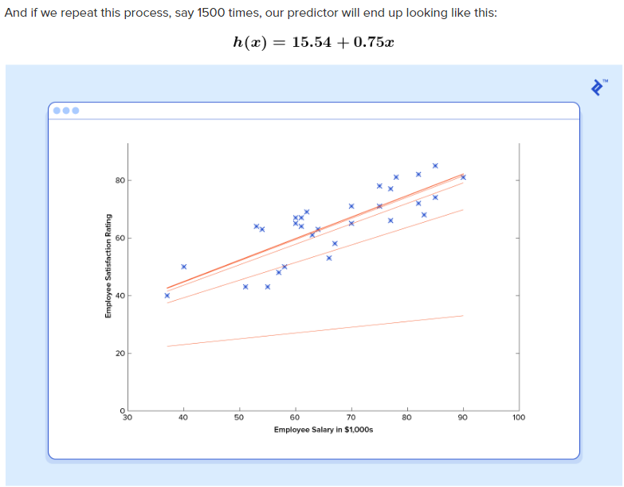

Slide 10
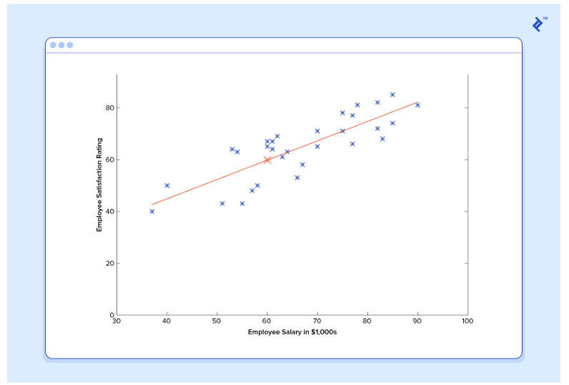
Optimal predictor – The convergence point where constants do not change by any appreciable value

Slide 11
Deep Learning
Deep Learning is a machine learning method.
It allows us to train an AI to predict outputs, given a set of inputs.
Both supervised and unsupervised learning can be used to train the AI.

Slide 12

Neural Networks

Slide 13
Example
We will learn how deep learning works by building an hypothetical airplane ticket price estimation service.
We will train it using a supervised learning method.
We want our airplane ticket price estimator to predict the price using the following inputs (we are excluding return tickets for simplicity):
Origin Airport
Destination Airport
Departure Date
Airline

Slide 14
Layers of Neural Networks
The input layer receives input data. In our case, we have four neurons in the input layer: Origin Airport, Destination Airport, Departure Date, and Airline. The input layer passes the inputs to the first hidden layer.
The hidden layers perform mathematical computations on our inputs. One of the challenges in creating neural networks is deciding the number of hidden layers, as well as the number of neurons for each layer.
The “Deep” in Deep Learning refers to having more than one hidden layer.
The output layer returns the output data. In our case, it gives us the price prediction.

Slide 15
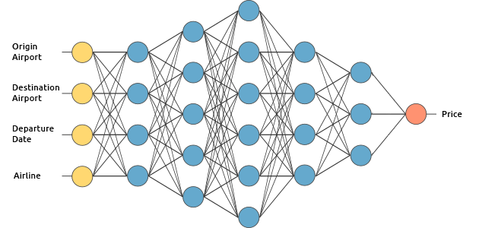
Air Ticket Price Estimation Engine

Slide 16
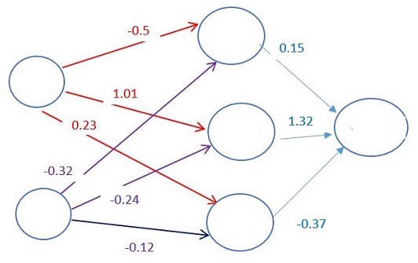
Weights and Neurons
Each connection between neurons is associated with a weight. This weight dictates the importance of the input value.

Slide 17
Train the Neural Network
Training the AI is the hardest part of Deep Learning. Why?
You need a large data set.
You need a large amount of computational power.

Slide 18

Gradient Descent
It works by changing the weights in small increments after each data set iteration. By computing the derivative (or gradient) of the cost function at a certain set of weight, we’re able to see in which direction the minimum is

Slide 19
Cost Function
Once we go through the whole data set, we can create a function that shows us how wrong the AI’s outputs were from the real outputs.
This function is called the Cost Function.

Slide 20
After multiple iterations through the data set, the most optimal price prediction model can be created

Slide 21
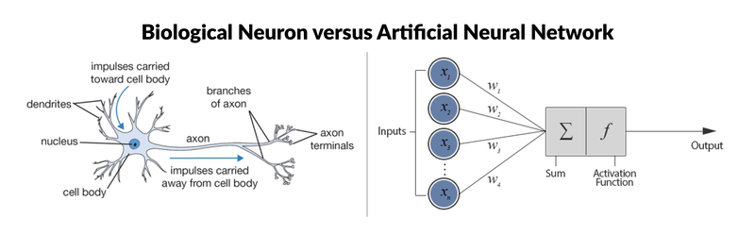
Human vs AI

Slide 22
List of programming languages for artificial intelligence
AIML
IPL
LISP
SMALLTALK
PROLOG
STRIPS
PLANNER
R (KERAS/TENSORFLOW)
PYTHON

Slide 23
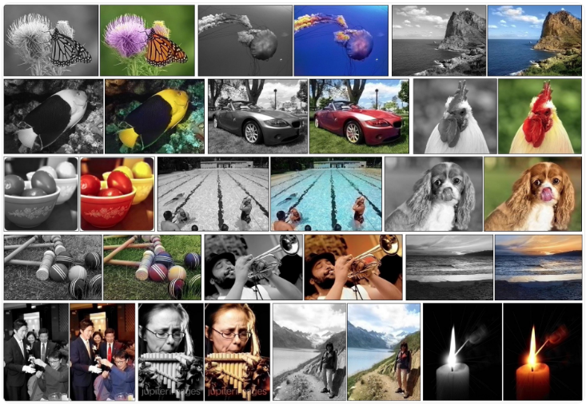
Applications of Deep Learning
Automatic Colorization of Black and White Images

Slide 24
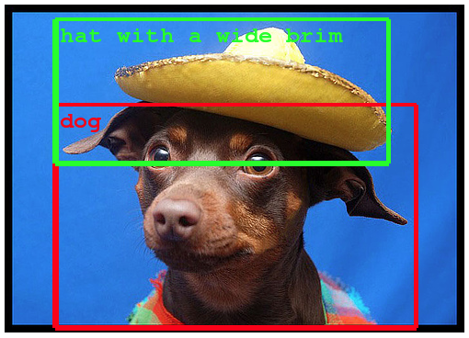
Applications of Deep Learning
Object Classification and Detection in Photographs

Slide 25
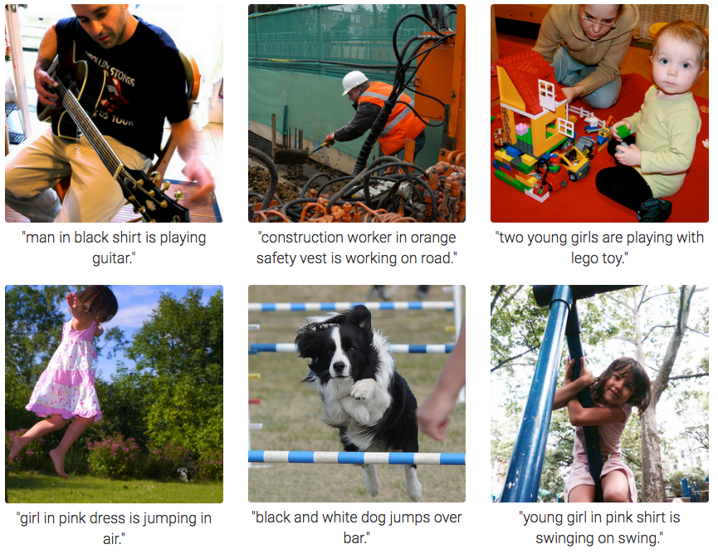
Applications of Deep Learning
Automatic Image Caption Generation

Slide 26
How AI Impacts Industries?
Banks such as UBS and Deutsche Bank use an AI engine called Sqreem (Sequential Quantum Reduction and Extraction Model) which can mine data to develop consumer profiles and match them with the wealth management products they’d most likely want
Wallet.AI, an upcoming startup in San Francisco, builds agents that analyze data that a consumer would leave behind, from Smartphone check-ins to tweets, to inform the consumer about their spending behavior
Goldman Sachs uses Kensho, a market analytics platform that combines statistical computing with big data and natural language processing. Its machine learning systems mine through hoards of data on the web and assess correlations between world events and their impact on asset prices
Underwriting - An online lender, Upstart, analyze vast amounts of consumer data and utilizes machine learning algorithms to develop credit risk models that predict a consumer’s likelihood of default

Slide 27
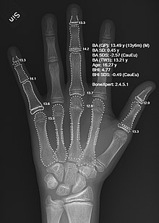
Medicine and AI
Computer-aided interpretation of medical images. Such systems help scan digital images, e.g. from computed tomography, for typical appearances and to highlight conspicuous sections, such as possible diseases. A typical application is the detection of a tumor.
Heart sound analysis
Companion robots for the care of the elderly
Mining medical records to provide more useful information.
Design treatment plans.
Assist in repetitive jobs including medication management.
Provide consultations.
Drug creation
Using avatars in place of patients for clinical training
Predict the likelihood of death from surgical procedures
Predict HIV progression
X-ray of a hand, with automatic calculation of bone age by AI

Slide 28

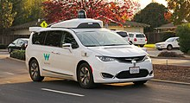
Automobiles and AI
Waymo is an autonomous car development
company and subsidiary of Google's parent company,
Alphabet Inc.

Slide 29
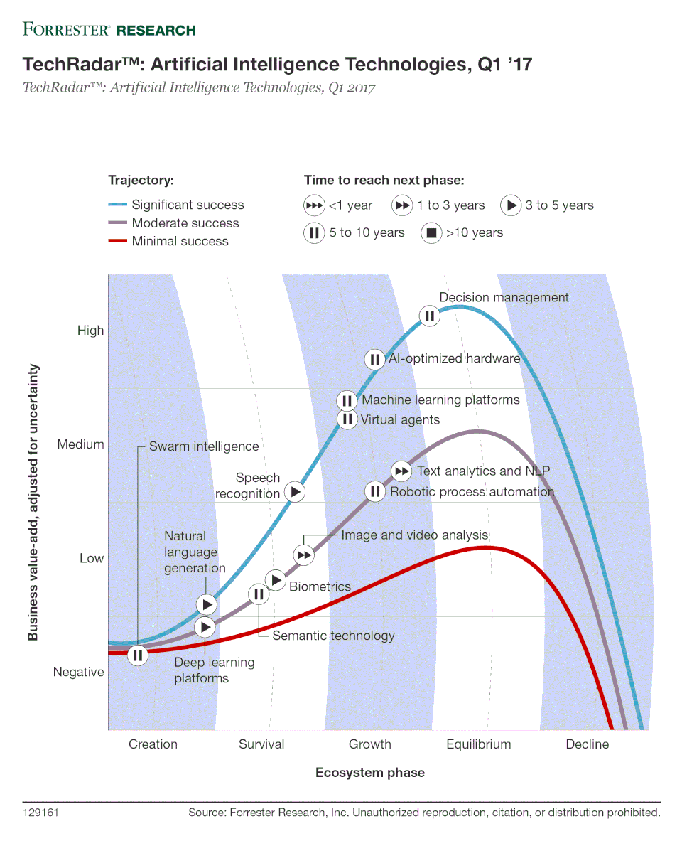

Slide 30
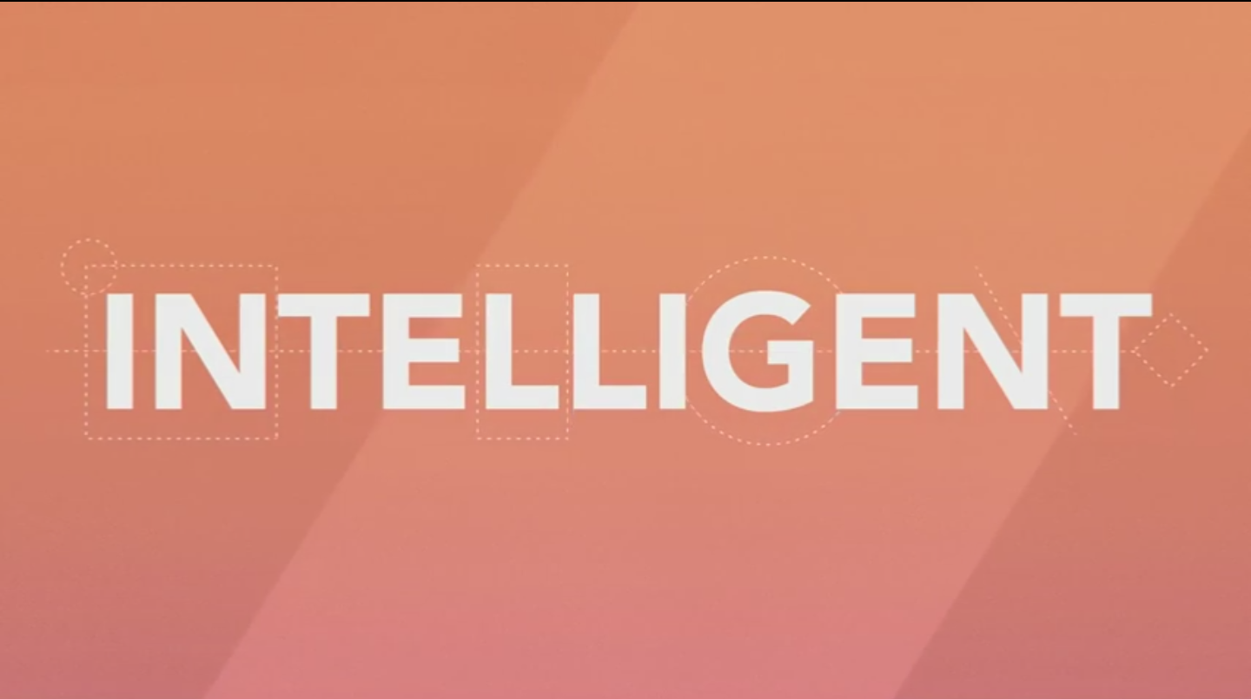
AI – The Future
Very soon, AI systems will become less Artificial and more Intelligent

Slide 31
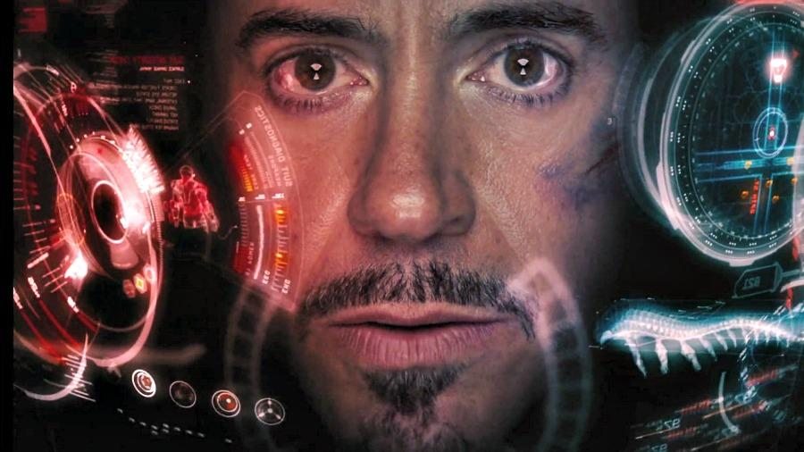

Slide 32

JARVIS

Slide 33
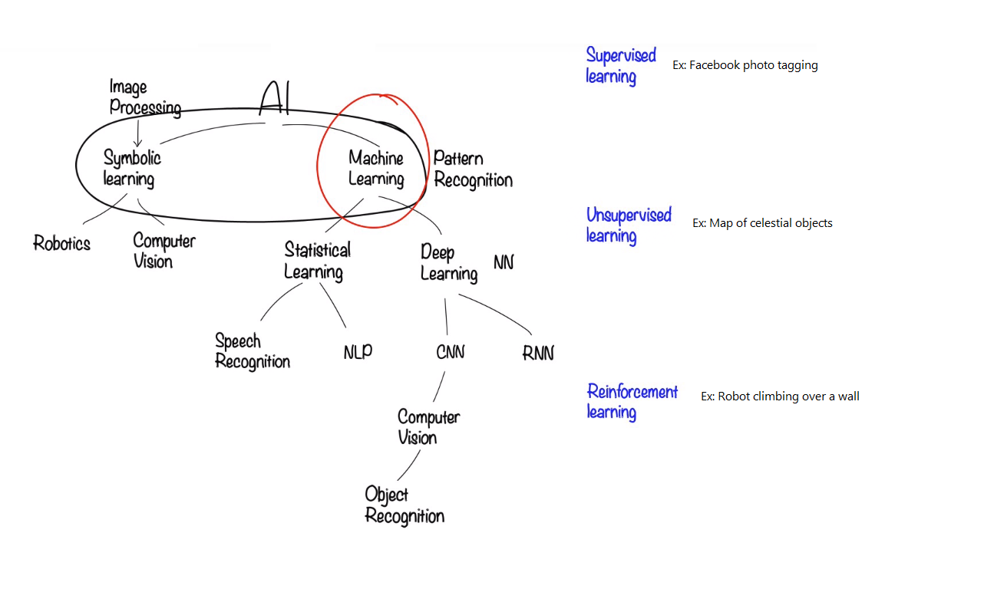







Slide 34
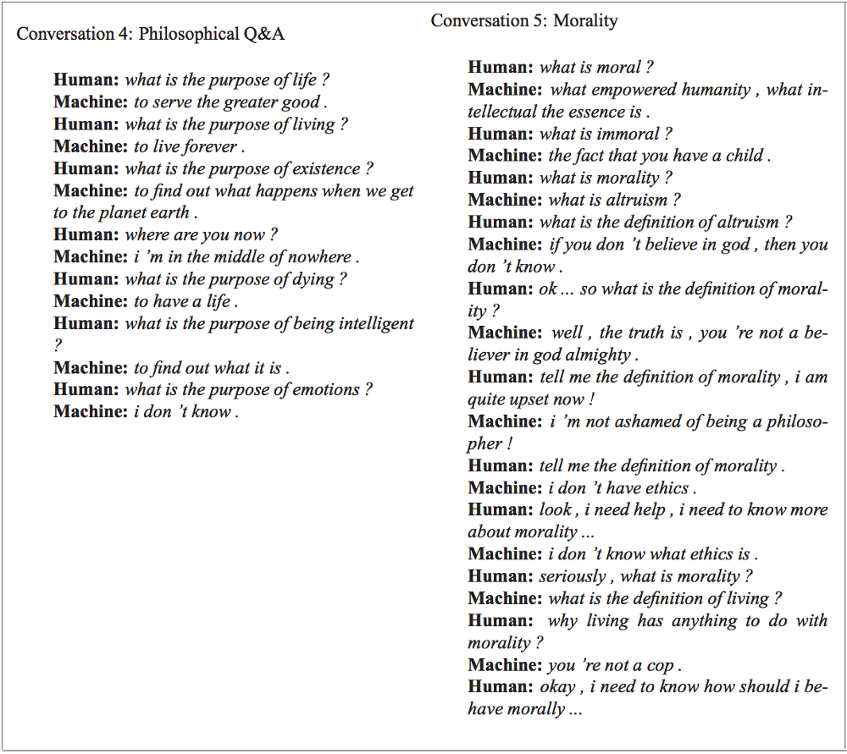
Statistical Learning
In 2015, Google trained a conversational agent (AI) that could
Convincingly interact with humans as a tech support helpdesk
Discuss morality, express opinions
Answer general facts-based questions.

Slide 35
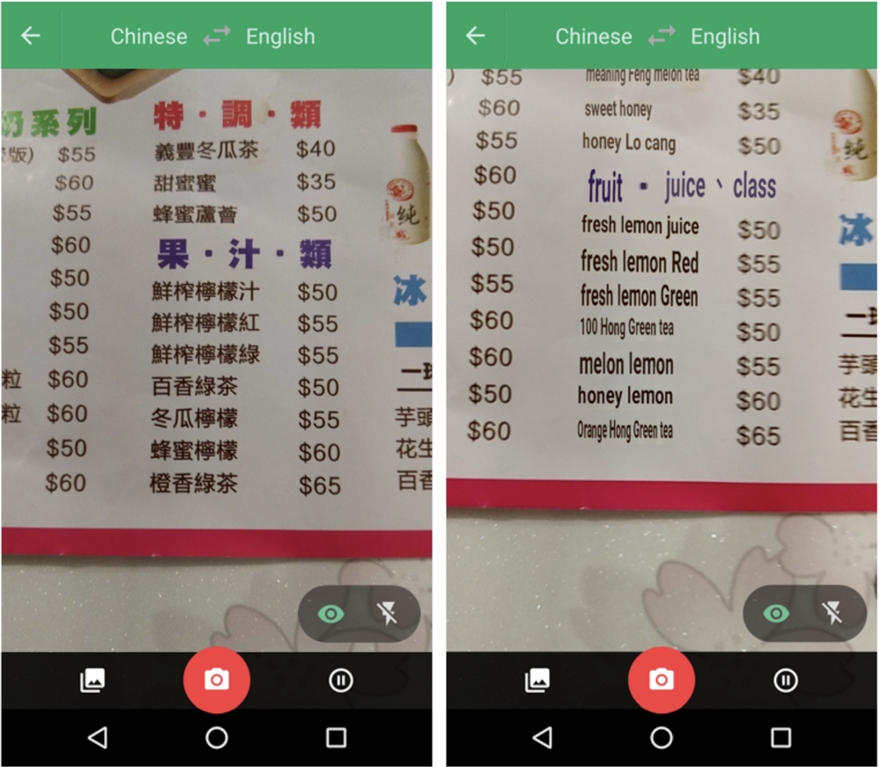
NLP
Google Translate can now:
Identify various language characters from images
Perform live translations

Slide 36


Slide 37
Comparison
AI
Artificial intelligence, or the outermost circle, can be defined as the capability of a machine to imitate intelligent human behavior
ML
Machine learning is defined by Stanford University as the science of getting computers to act in specific ways without explicitly programming them to do so.
DL
Deep learning is a form of machine learning that is inspired by the structure of the human brain and is particularly effective in feature detection.

Slide 38
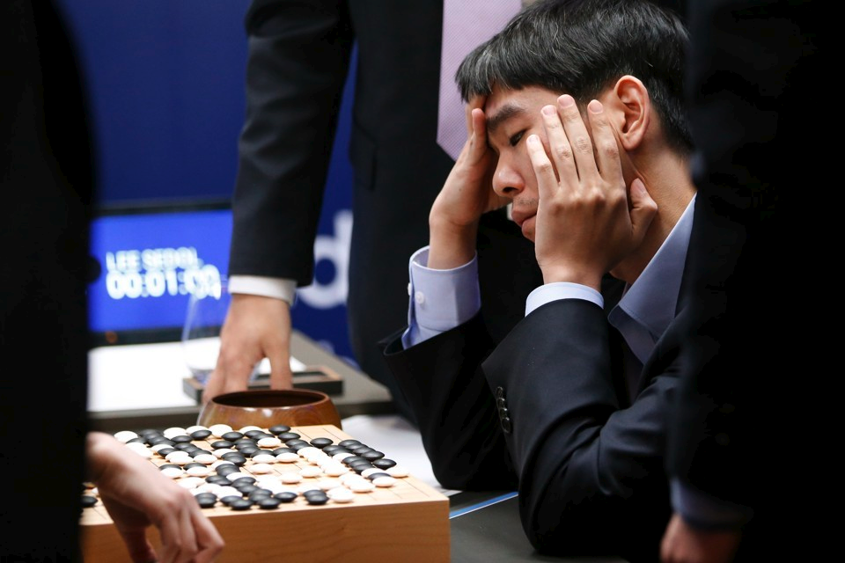
AI vs Humans
Go is an ancient Chinese war strategy game
10¹⁷⁰ possible board positions
AlphaGo defeated world’s best Go player in 2016
Professional Go player Lee Sedol reviewing his match with AlphaGo after defeat

Slide 39
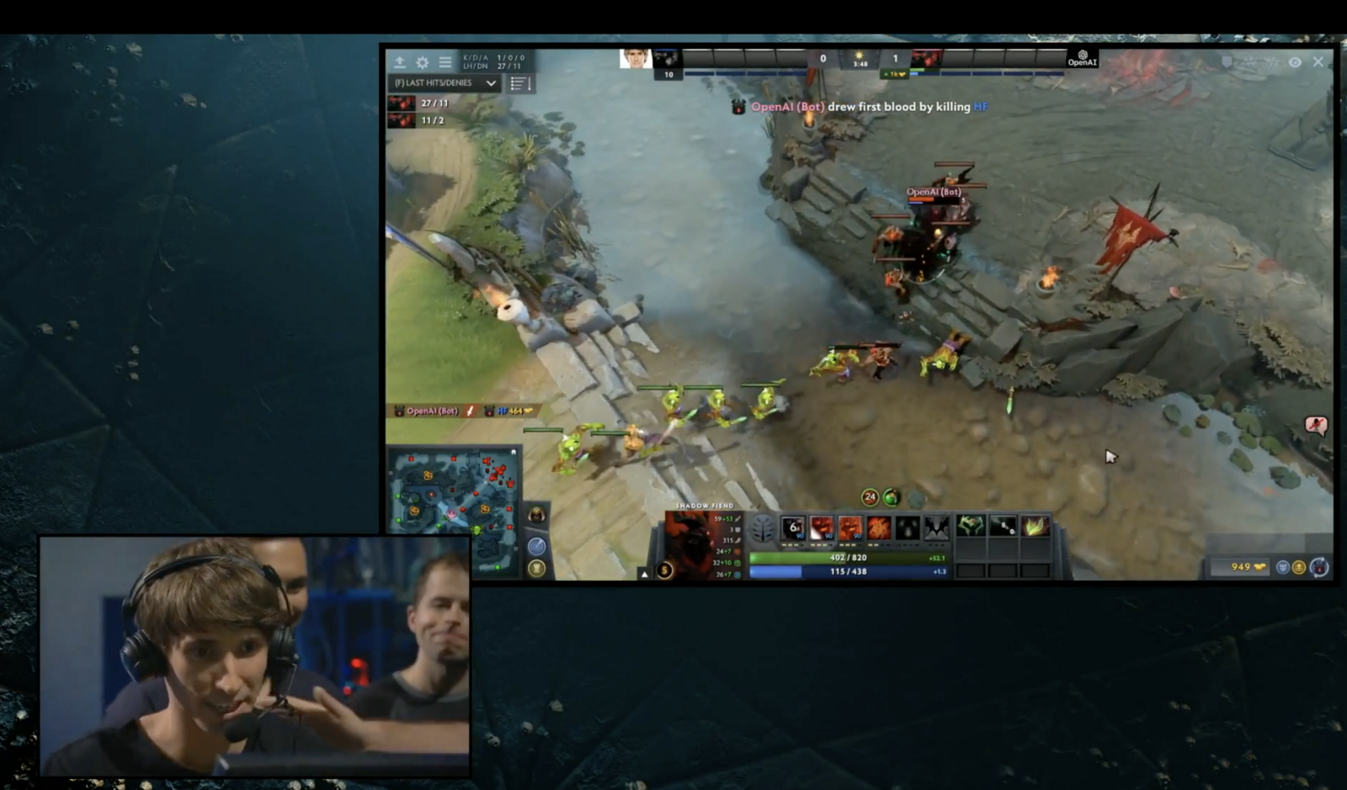
AI vs Humans
DOTA 2 is an online multiplayer game
OpenAI, a non-profit AI research organization
OpenAI’s bot defeated world’s best DOTA player
Dendi, world’s best DOTA player lost to OpenAI

Slide 41
https://www.analyticsvidhya.com/blog/2017/04/comparison-between-deep-learning-machine-learning/

